Slide 1
UHECR Detection Methods
Erin Levesque, Privitera Lab
University of Chicago’s Kavli Institute for Cosmological Physics

Slide 2
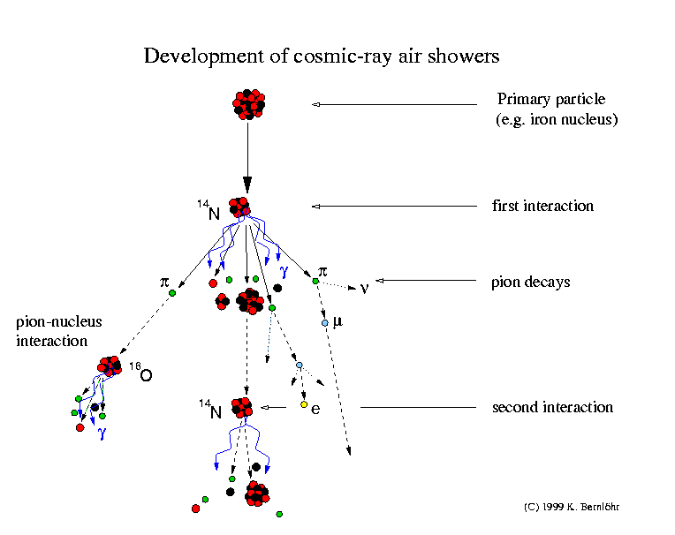
Ultra-High Energy Cosmic Rays
Cosmic Rays - high speed, charged particles
What are the sources?
How are they being accelerated?
UHECRs measured through the detection of extensive air showers (EAS)
CRs with energies above 10²⁰ eV have an estimated arrival rate of only 1/km² per century
Diagram of CRs entering the atmosphere and dispersing into extensive air showers
https://www.mpi-hd.mpg.de/hfm/CosmicRay/Showers.html

Slide 3
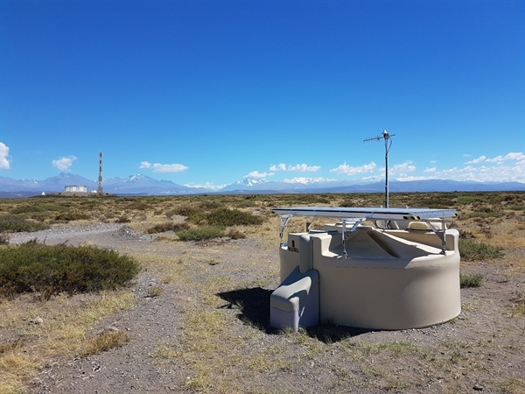
Pierre Auger Observatory
World’s largest cosmic ray observatory
UHECRs measured through the detection of EAS
Hybrid detection
Water particle detection stations
Fluorescent telescopes
Pierre Auger Observatory, Mendoza Province, Argentina
https://www.ru.nl/english/

Slide 4
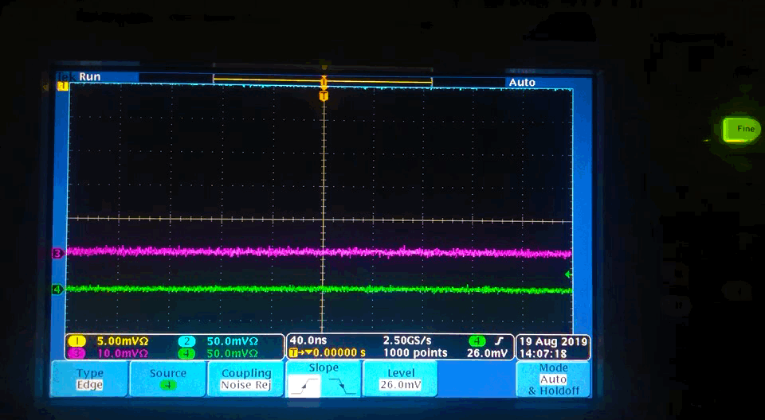
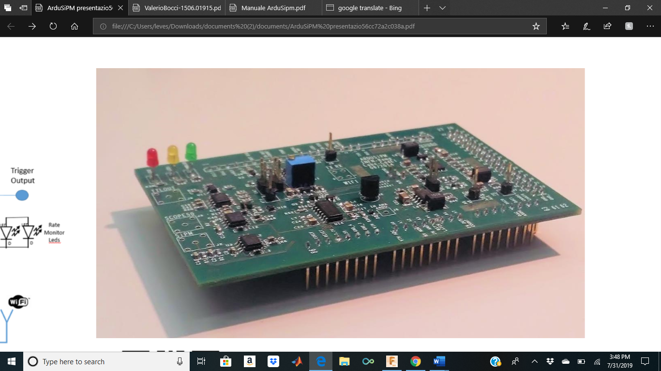
The ArduSiPM Muon Detector
Low-cost, portable muon particle detector and data acquisition system
Two plastic scintillators and silicon photomultipliers (SiPMs)
Arduino DUE (an open Software/Hardware board) as processor board
A custom designed board (ArduSiPM Shield) that attaches to the DUE
Contains the electronics interface from Arduino DUE and a SiPM photodetector
Trigger output from one Scintillator
Custom ArduSiPM Shield

Slide 5
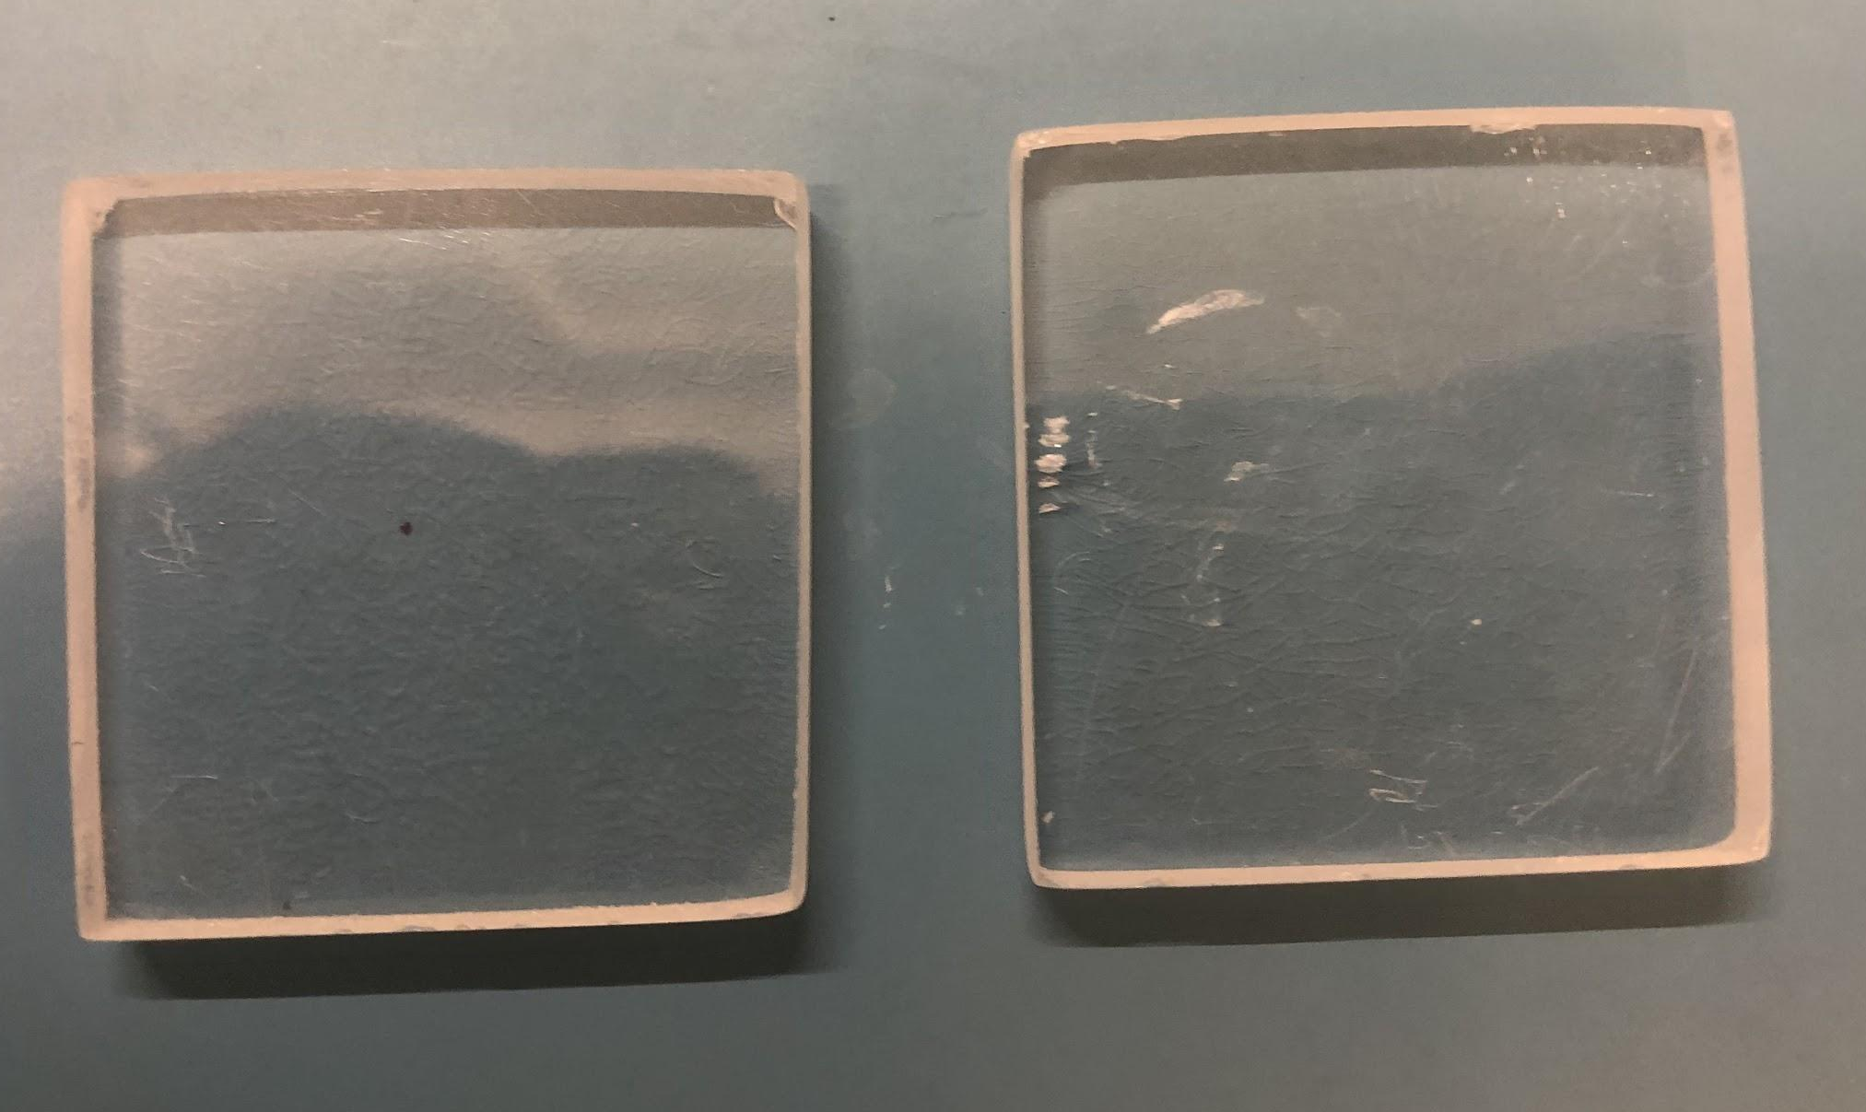
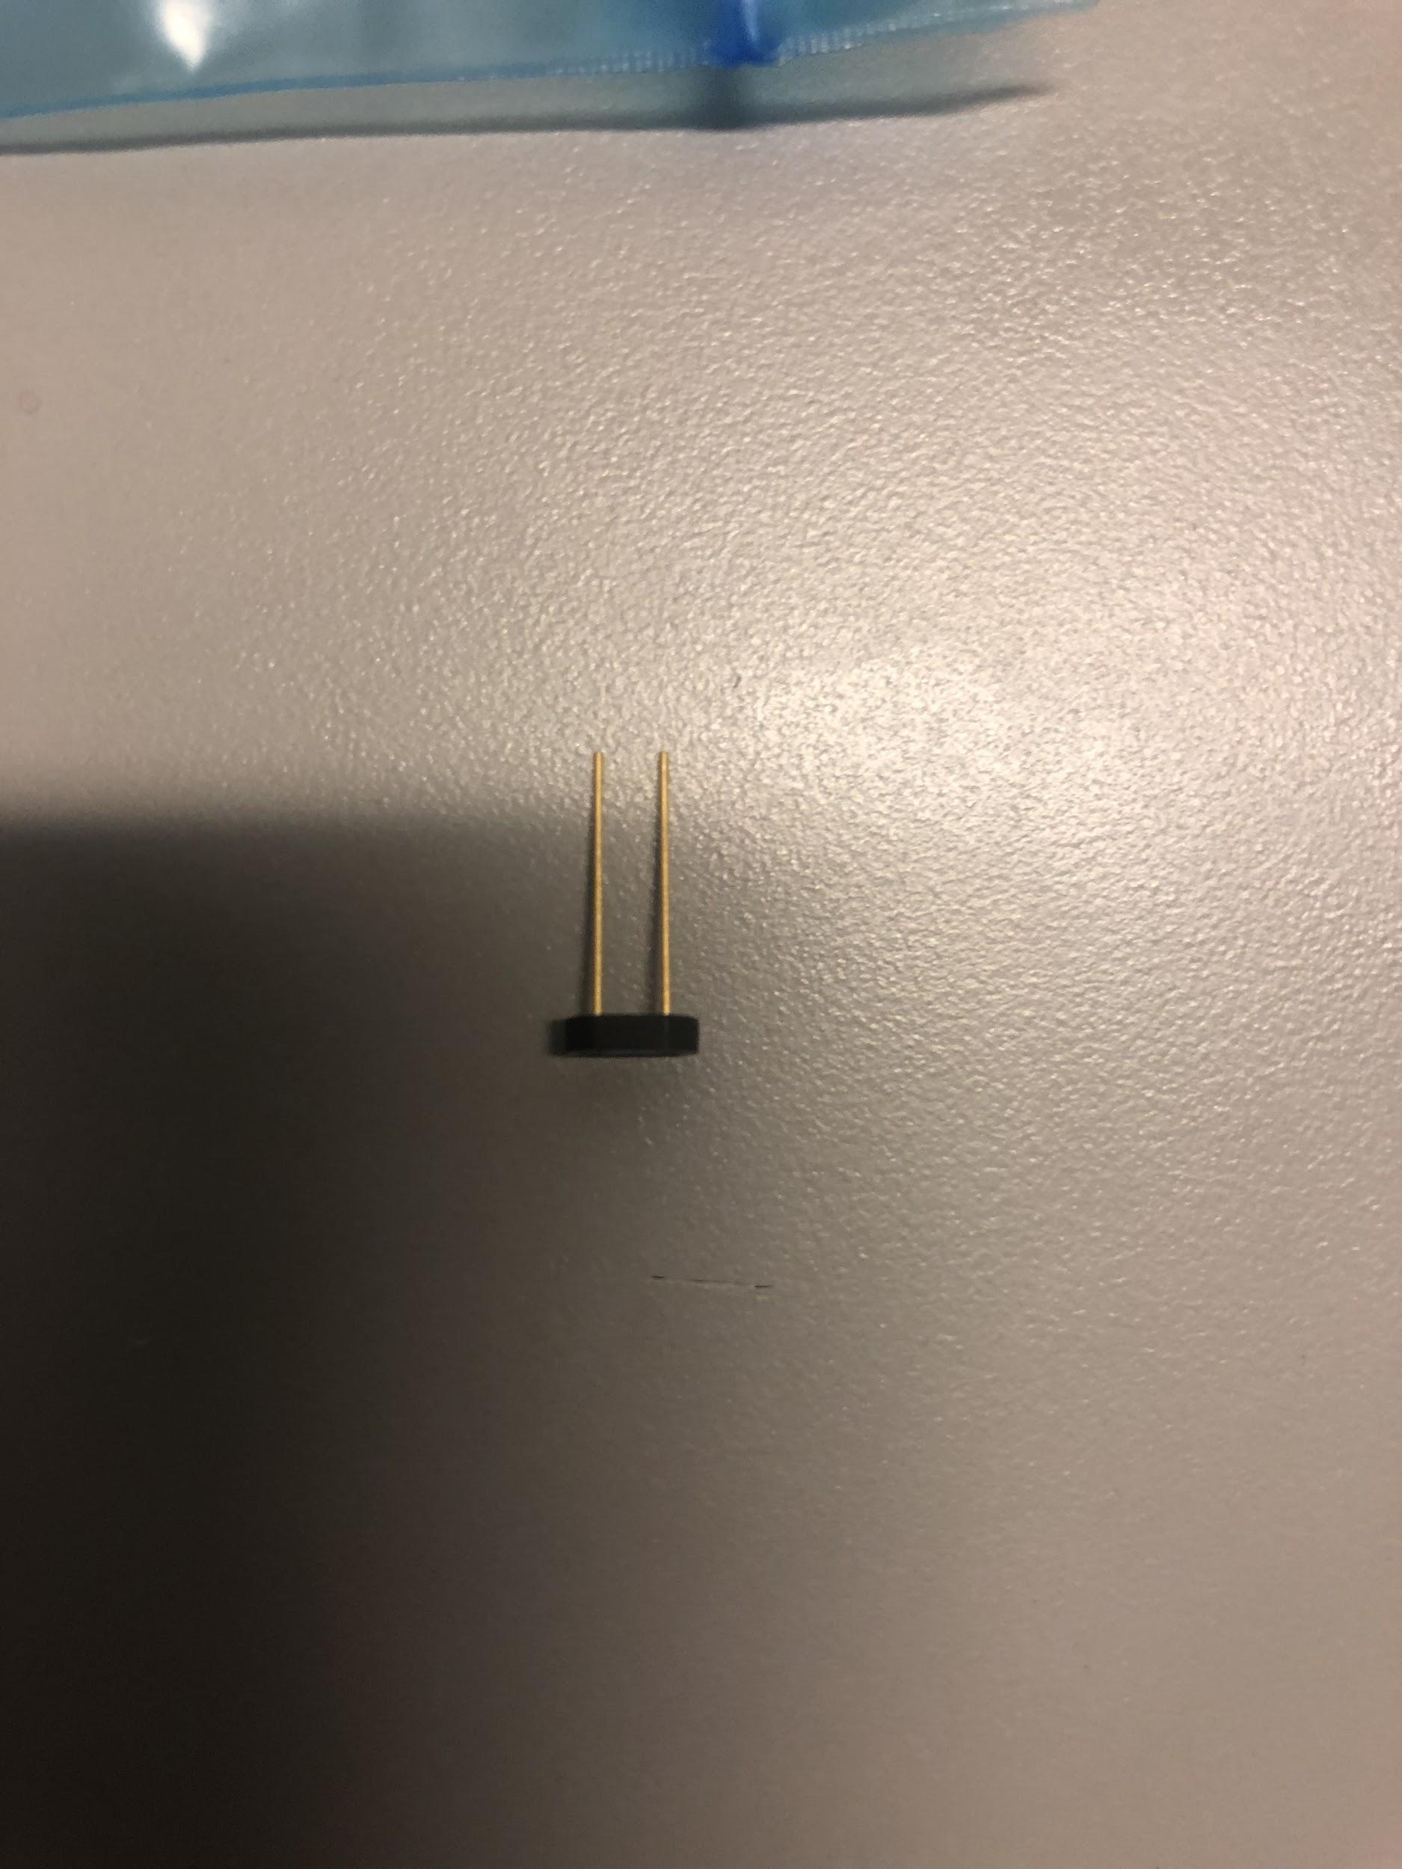
Detection using Scintillation
Scintillation: exciting the atoms/molecules in target material, causing light emission
Photons detected by SiPM
Muons easily distinguished from other particles
Plastic Scintillators
SiPM

Slide 6
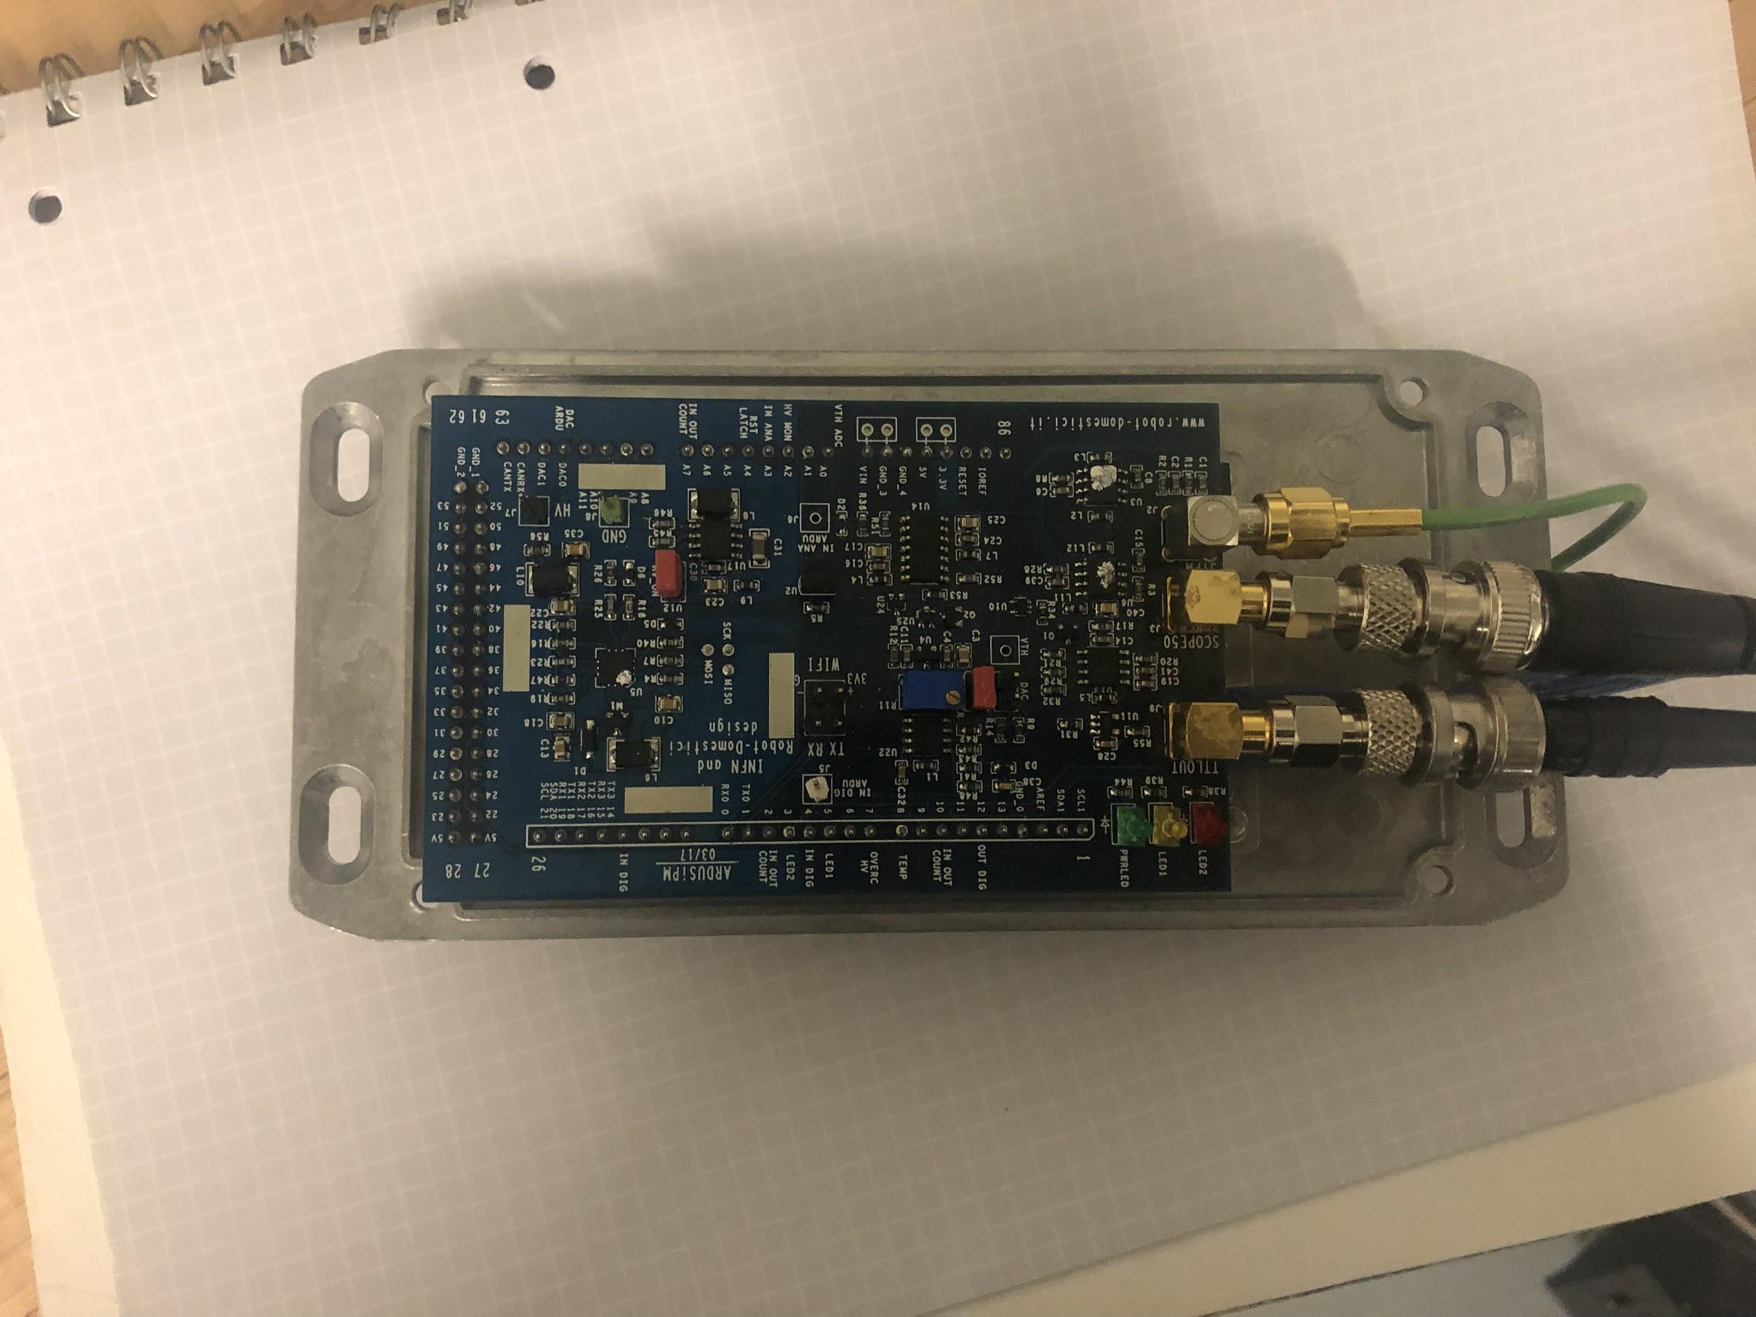
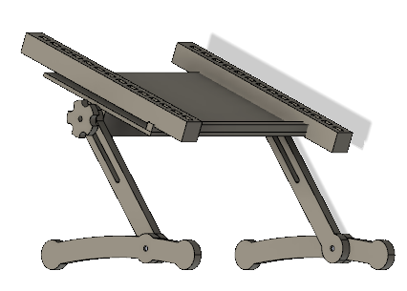
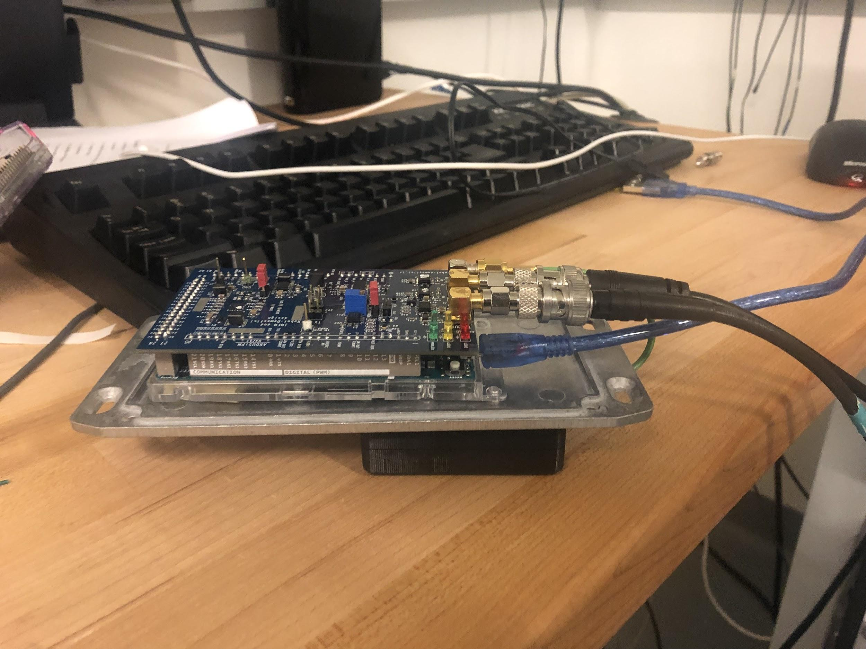
Mechanical Support for Data Acquisition
Observe coincidences by keeping scintillators in parallel
Alter the distance between the scintillators and angle of detection

Slide 7
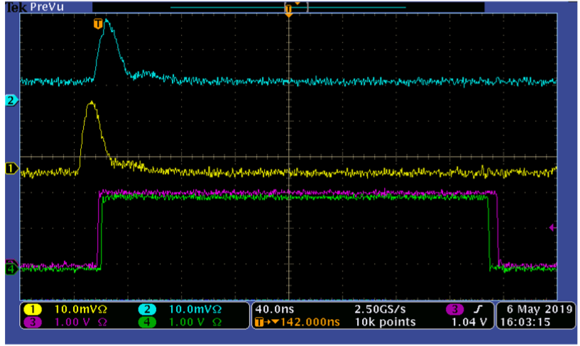
Troubleshooting and Future Work with Muon Detector
Compare how accuracy is affected by scintillator size
Input a GPS unit to synchronize acquisition window
Compare laboratory results to other locations of various altitudes
Scope trace of a signal passing through two scintillators and their corresponding triggers (Harry Ni 2019)

Slide 8
References
[1] https://arxiv.org/ftp/arxiv/papers/1411/1411.7814.pdf
[2] https://www.youtube.com/watch?v=_g79uppMX-Y
[3] https://www.researchgate.net/publication/318959067_The_Fluorescence_detector_Array_of_Single-pixel_Telescopes
_Contributions_to_the_35th_International_Cosmic_Ray_Conference_ICRC_2017

Slide 9



Acknowledgements
Paolo Privitera, John Farmer, Jalen Crump, and all those in the Privitera Lab Group
The University of Chicago REU Program
The National Science Foundation

